Slide 1
Early January.

Slide 2
23rd January.

Slide 3
February.

Slide 4
Mid-March.
Quarantine starts in your country.

Slide 5
Mid-March.
Quarantine starts for you.

Slide 6



You need to adapt.
Change your routine.
And maintain those efforts until the end of quarantine.

Slide 7

Fear is fading.
You may lower your guard.
Mistake.

Slide 8
OVI.
Overcome VIrus
Help users
maintain
good practices

Slide 9


Create new habits.
Funny, interactive game.
+
Visualize yourself achieving the goal.

Slide 10
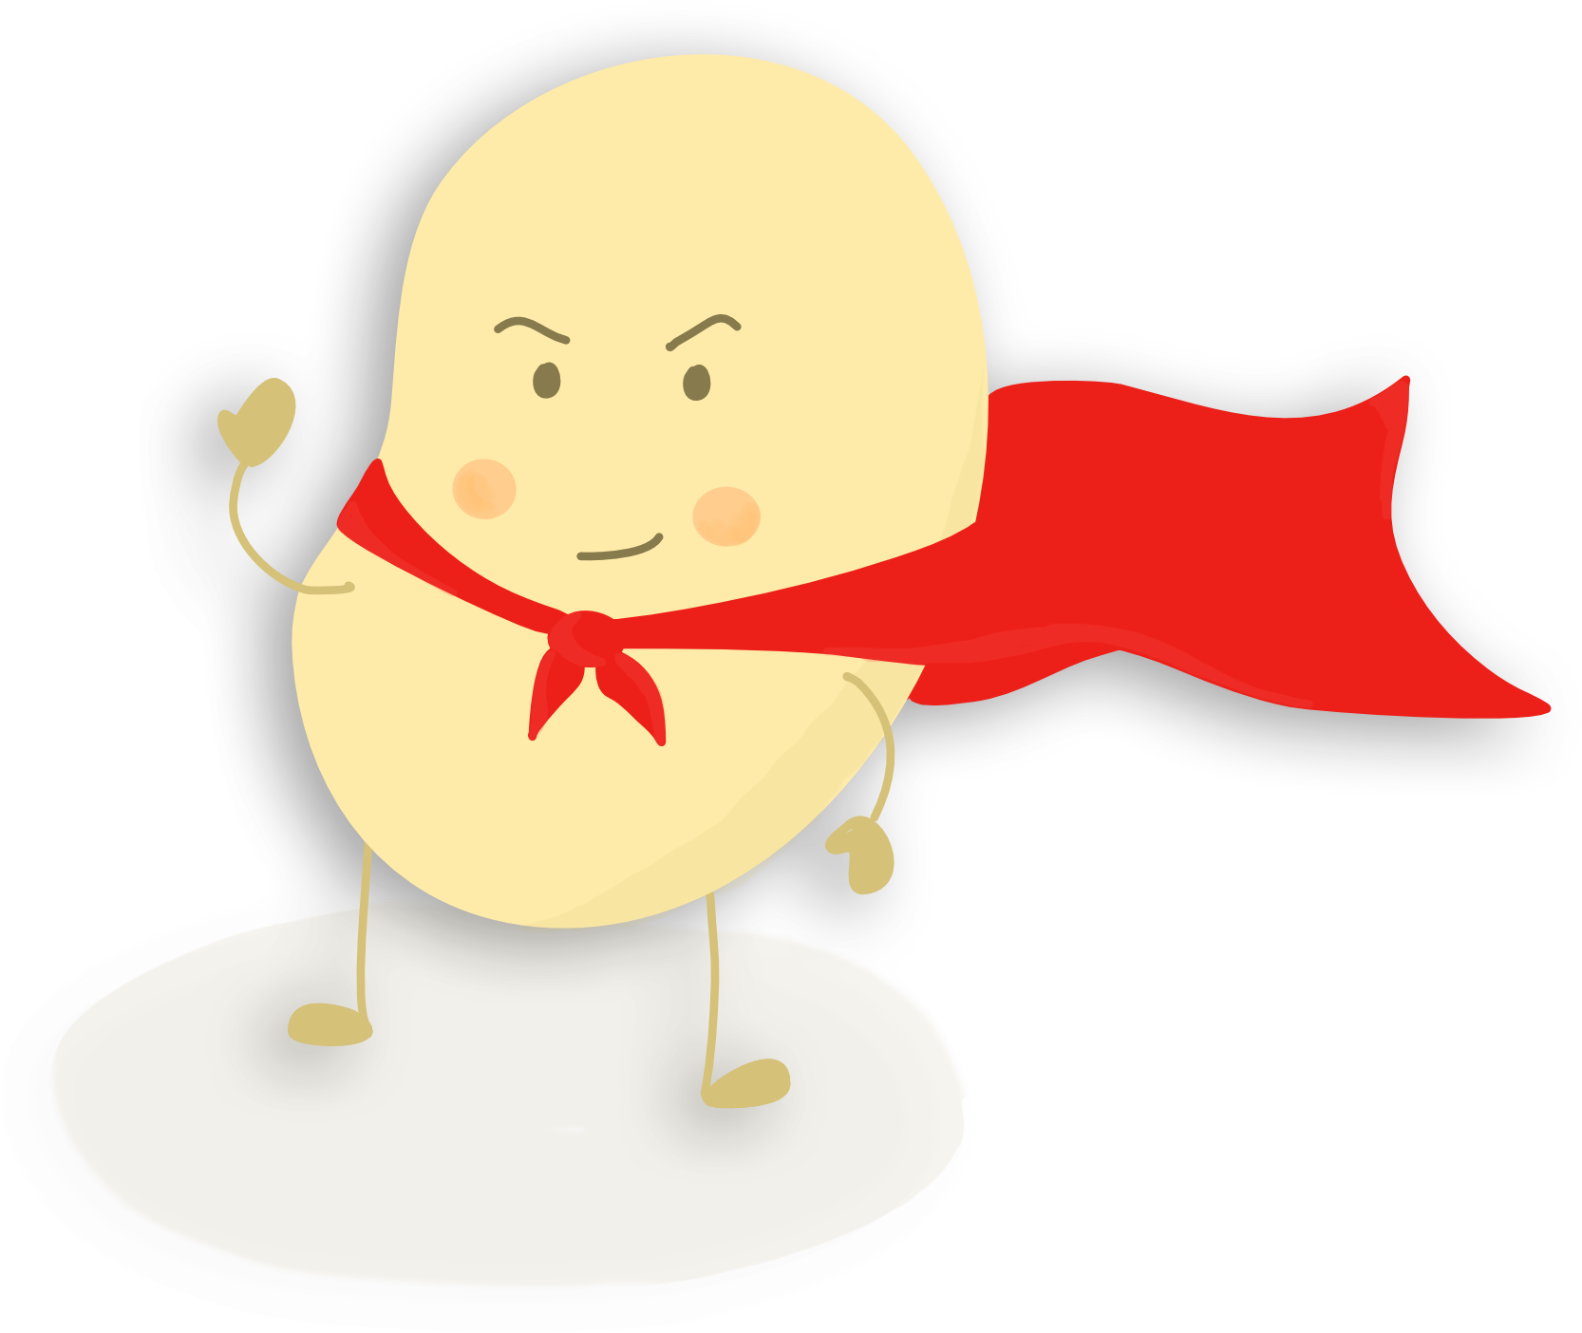
A virtual buddy to help you fight Covid19.
A cute character that mirrors
your behavior.
Make it survive, day after day until the end of the quarantine, by enforcing healthy practices.
Reflect unconsciously this behavior on yourself.
YOUR OVI

Slide 11
Thank you and stay safe!

Slide 12
References
https://blog.iqmatrix.com/visualization

